Slide 1
SJWs EXPOSED! in a world gone mad Up is down, left is right
SJWs EXPOSED! in a world gone mad Up is down, left is right
Notes:
Social Justice Warriors (SJWs)

Slide 2
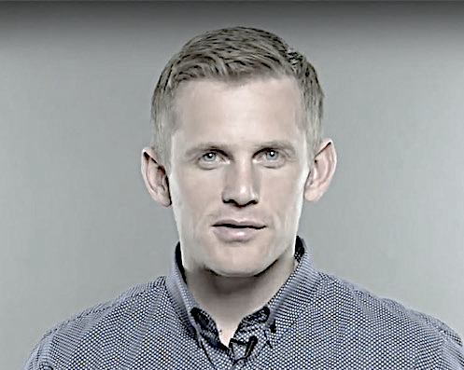
SJWs EXPOSED! in a world gone mad Up is down, left is right
SJWs EXPOSED! in a world gone mad Up is down, left is right
Joseph Backholm Family Policy Institute of Washington
Featured videos:
Gender identity: can a 5'9", white guy be a 6'5", Chinese woman?
Do college kids know the difference between men and women?
Notes:
LGGBDTTTIQQAAPP stands for Lesbian, Gay, Genderqueer, Bisexual, Demisexual, Transgender, Transsexual, Twospirit, Intersex, Queer, Questioning, Asexual, Allies, Pansexual, and Polyamorous.

Slide 3
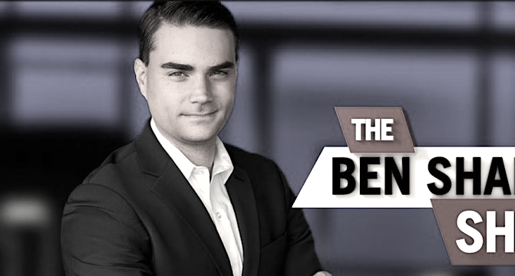
“
“
Facts don’t care about your feelings... There is no such thing as ‘your truth.’ There is the truth and your opinion.”
Facts don’t care about your feelings... There is no such thing as ‘your truth.’ There is the truth and your opinion.”
Ben Shapiro The Daily Wire
Featured videos:
The moment this transgender debate got heated
Dangerous people are teaching your kids
Sassy student calls Ben Shapiro transphobic
Notes:
“When someone calls you a racist, sexist, bigot, homophobe because you happen to disagree with them about tax policy or same-sex marriage or abortion, that’s bullying. When someone slanders you because you happen to disagree with them about global warming or the government shutdown, that’s bullying.” ― Ben Shapiro

Slide 4
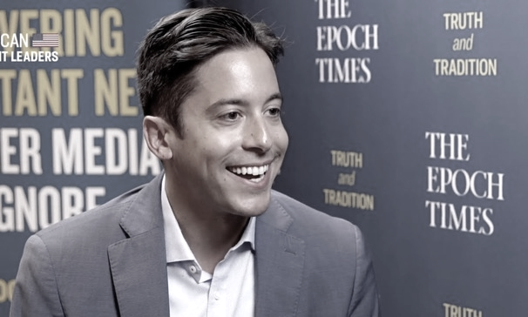
SJWs EXPOSED! in a world gone mad Up is down, left is right
SJWs EXPOSED! in a world gone mad Up is down, left is right
Michael Knowles The Michael Knowles Show
Featured videos:
A cocky SJW’s inflated ego
SWJ spits on the grave of Columbus
How the Left always gets everything backward

Slide 5
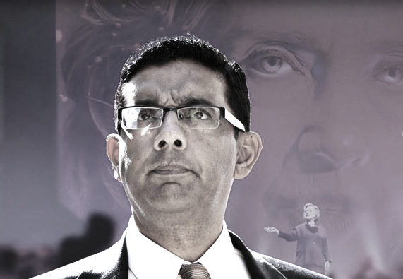
SJWs EXPOSED! in a world gone mad Up is down, left is right
SJWs EXPOSED! in a world gone mad Up is down, left is right
Dinesh D’Souza D’Souza Media
Featured videos:
Absolutely DESTROYS Leftist college student
Seizure of another man’s labor… does this sound like capitalism to you?
Notes:
https://www.dineshdsouza.com

Slide 6
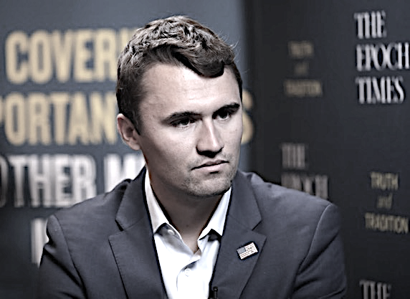
SJWs EXPOSED! in a world gone mad Up is down, left is right
SJWs EXPOSED! in a world gone mad Up is down, left is right
Charlie Kirk The Charlie Kirk Show
Featured videos:
Greatest takedown of the Left’s abortion argument

Slide 7
SJWs EXPOSED! in a world gone mad Up is down, left is right
SJWs EXPOSED! in a world gone mad Up is down, left is right
Candace Owens The Candace Owens Show
Featured videos:
Destroying the Leftists narrative at U.S. House Hearing
Under Sharia Law some murder is ok

Slide 8
SJWs EXPOSED! in a world gone mad Up is down, left is right
SJWs EXPOSED! in a world gone mad Up is down, left is right
Will Witt PragerU
Featured videos:
Is an eagle egg more valuable than a baby?
How many genders are there?
Do Americans trust the news media?
Can you find Iran on a map?
Notes:
https://www.prageru.com/presenter/will-witt/

Slide 9
SJWs EXPOSED! in a world gone mad Up is down, left is right
SJWs EXPOSED! in a world gone mad Up is down, left is right
Dennis Pragur PrugerU
Featured videos:
The dark art of framing
What is fake news? Covington Catholic
Climate activists use kids to fuel hysteria, Bjorn Lomborg

Slide 10
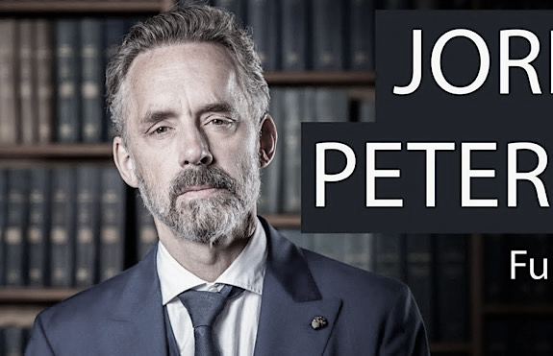
SJWs EXPOSED! in a world gone mad Up is down, left is right
SJWs EXPOSED! in a world gone mad Up is down, left is right
Dr. Jordan B Peterson Canadian clinical psychologist
Featured videos:
People getting offended
Destroys feminist narrative
Don’t blame others. Fix yourself

Slide 11
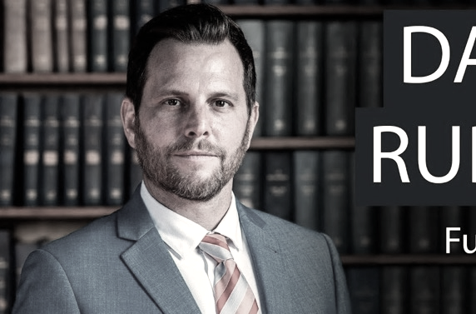
“
You don’t learn anything when you watch CNN. You will actually be dumber having watched CNN.”
“
You don’t learn anything when you watch CNN. You will actually be dumber having watched CNN.”
Dave Rubin The Rubin Report
Featured videos:
Leaving the Left – as interviewed by John Stossel of Stossel TV
Notes:
David Joshua Rubin is a YouTube personality, and talk show host. He is the creator and host of The Rubin Report, a political talk show on BlazeTV and YouTube, and which was formerly part of The Young Turks Network and Ora TV.

Slide 12
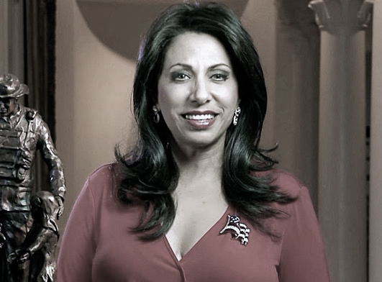
“
The peaceful majority were irrelevant… it is time we take political correctness and throw it in the garbage where it belongs.”
“
The peaceful majority were irrelevant… it is time we take political correctness and throw it in the garbage where it belongs.”
Brigitte Gabriel Author of Because They Hate
Featured videos:
A BRILLIANT answer about the peaceful Muslim majority

Slide 13
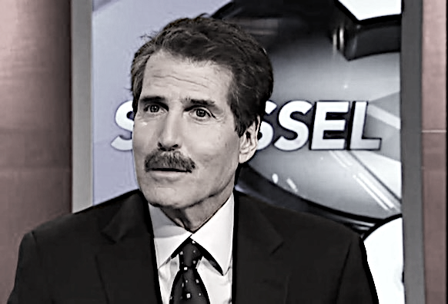
SJWs EXPOSED! in a world gone mad Up is down, left is right
SJWs EXPOSED! in a world gone mad Up is down, left is right
John Stossel Stossel TV
Featured videos:
The Paris climate fraud
Green New Deal: fact versus fiction

Slide 14
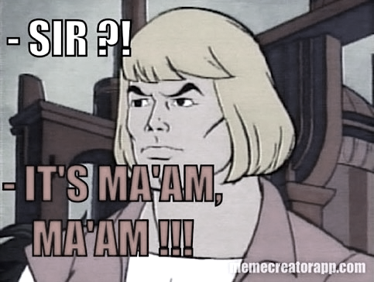
SJWs EXPOSED! in a world gone mad Up is down, left is right
SJWs EXPOSED! in a world gone mad Up is down, left is right
Everything Crazy SJW’s propaganda at its finest
Featured videos:
“It’s Ma’am” (WARNING: extreme profanity)
Matt Walsh wrecks transgender argument
Stop climate change alarmism
Dr. Jason Lisle DESTROYS flat earth NONSENSE!

Slide 15
SJWs EXPOSED! in a world gone mad Up is down, left is right
SJWs EXPOSED! in a world gone mad Up is down, left is right
Want some more
“propaganda?”
Here you go…
Featured videos:
People confuse Obama’s comments with Trump’s
Matt Walsh educates biology student on biology
Abortion is never medically necessary
Notes:
Leftists are telling children that climate change is going to kill them and everyone they know—and then place those terrified kids in front of cameras to beg for their lives. Want some "propaganda"? Here you go.

Slide 16
SJWs EXPOSED! in a world gone mad Up is down, left is right
SJWs EXPOSED! in a world gone mad Up is down, left is right
What’s missing? Fact-base discussion!
Featured videos:
President Trump has kids in cages
Climate change: what do scientists say?
David Horowitz brilliantly exposes Hamas on American college campuses

