Slide 2
Christian Apologists & Commentators
Christian Apologists & Commentators
The Gospel Coalition
What Would You Say? Joseph Backholm
Cross Examined Frank Turek & Jorge Gil
What about those who never hear about Jesus?
How is Christianity categorically different from every other religion?
There’s no evidence that God exists | existence of God | does God exist?

Slide 3
Pastor Mike Winger
Reasons to Believe Dr. Hugh Ross
Wretched Todd Friel
America’s preachers are gospel ignorant | with Pastor Paul Washer
The evil God of the Old Testament?
How long are the creation “days” in Genesis 1?

Slide 4
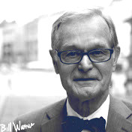
k
Acts 17 Apologetics David Wood
One Minute Apologist Bobby Conway
Political Islam Dr. Bill Warner, PhD
Is Jesus God?
Jihad vs. Crusades
Three Quran verses every Christian should know

Slide 5
Inspiring Philosophy Michael Jones
Got Questions Your Questions. Biblical Answers.
Living Waters Ray Comfort
15 Things to NEVER say to an atheist
Who will go to heaven?
The quantum God | the emergent universe

Slide 6
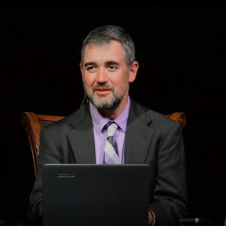
Capturing Christianity Cameron Bertuzzi
Justin Peters Ministries
Reasons for Jesus Steven Bancarz
A historian explains the evidence for the resurrection of Jesus | with Dr. Gary Habermas
Question & Answers | Word-of-faith movement
New Age to Jesus | my testimony

Slide 7
A & Ω Productions
American Gospel
Tree of Life Ministries Israel
Why do preachers lie to you? | false gospel 2020
American Gospel: Christ Alone (1-hour version)
The forbidden chapter: Isaiah 53 in the Hebrew Bible

Slide 8
Apologia Studios Pastor Jeff Durbin
Reasonable Faith Dr. William Lane Craig
Grace to You Pastor John MacArthur
Jeff Durbin explains predestination
An atheist answers Dr. Craig’s five points
John MacArthur on a Pastor’s authority

Slide 9
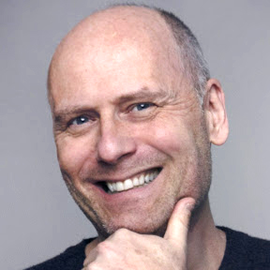
Stefan Molyneux Freedomain
Pat Condell
Catholic Answers
Why political correctness must end | with Milo Yiannopoulos
(NOTE: offensive language)
Message to offended Muslims
Is it true that there is no truth?

